Slide 1
Cloning of Hybridoma cells

Slide 2
Cloning
The requirement for continued storage of cells at all stages is essential for the following reasons:
Throughout cloning, particularly during the early stages, there is a high probability of chromosome loss and consequent loss of Ig secretion from the hybridoma cells.
There is always a risk of overgrowth by Ig-nonproducing hybridomas
c. The risk of infection
The types of hybridoma cells depends on the number of epitopes of the injected Ag.
The purpose of cloning is to isolate a single-specific Ab-secreting cell from the hundreds of other cells in the culture. So that Monoclonal cell line can be established.

Slide 3
Test of FCS for ability to support hybrid clones
A prerequisite is the need for a medium in which hybridoma cells may be grown from very low densities . Each new patch of FCS must be tested for the ability to support hybrid clones.
Usually the growth of hybrids is inhibited at high cell dilutions. This can be overcome by the use of feeder cells such as thymocytes, peritoneal macrophages or spleen cells.
hybrids are seeded into culture wells containing such cells.
1 thymus/96-well plate +wash medium + 10 cells /100 uL/well
(12 wells or 1 row)
5% FCS (to be tested) in medium + -ve and + ve controls
After 5 days score each well for hybrid growth

Slide 4
1. B cells (specific and nonspecific) + Myeloma cells HAT & PEG
Hybridoma cells survive only
2. Specific (e.g 10 hybridoma cells against 10 injected Ag epitopes) survive
Nonspecific e.g 10⁴ hybridoma cells against different epitopes survive also
3. Limiting dilution and ELISA
Isolation of each specific hybridoma cell alone
Each specific Hybridoma cell divides in culture to make a clone that secrete specific Mab against one epitope. 10 hybridoma clone each secretes a specific Mab
4. Nonspecific hybridoma cells give negative in ELISA and not selected

Slide 6
Cloning by limiting dilution
The objective is to set up at least 3 very low dilutions of cells resulting in a mean of 1 cell/well.
Within 2 weeks of cloning, clones should be visible macroscopically and some of the wells contain monoclonal growth.
At this stage, each of the cell supernatant should be screened to determine which of them contains the desired Ab.
Positive wells are expanded and recloned at least 3 times
The final clone should display positive Ab production in all the seeded wells.
A proportion of each culture should be frozen and stored.

Slide 7
Hybridoma cell mixture. Count them Make dilution to 2000 cell/ml= diluted Hyb cells Add 100 uL media to every 96 well Pipett 100 uL of diluted Hyb cell to A1 well then serial dilution horizontally to A12 Make serial dilution to each well starting from column A1 to H1, A2 to H2 itc…… Let the cells grow ELISA screening Repeat the same dilution procedure for every positive clone
1
4
5
6
7
8
9
10
11
12
2
3
A
H1 |  | H3 |  |  | H6 |  |  |  |  |  | H12
B
C
+
D
+
-
E
+
F
+
G
+
+
H
+

Slide 8
For each Positive clone. Count the cells Make dilution to 2000 cell/ml= diluted positive clone Add 100 uL media to each well Pipett 100 uL of positive clone to A1 well then serial dilution horizontally to A12 Make serial dilution to each well starting from column A1 to H1, A2 to H2 itc…… Let the cells grow ELISA screening Repeat the same dilution procedure for every positive clone
1
4
5
6
7
8
9
10
11
12
2
3
A
H1 |  | H3 |  |  | H6
B
+
C
D
E
F
G
H
+
+
-
+
+
+

Slide 9
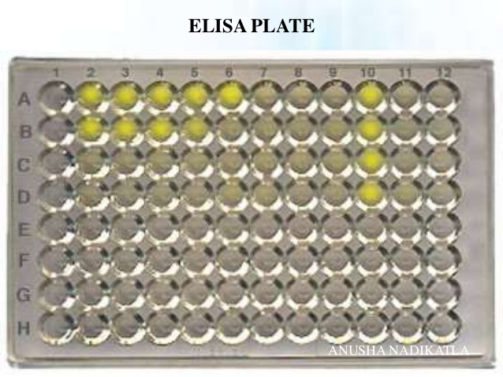

Slide 10
Alternative dilution procedure
Dilute the hybridoma cells to 2000 cells/ml
100 µL of these + 3.9 ml of thymocyte medium makes 4 ml
Plate 24 wells (row A & B) of 96-well plate 100 µL each (5 cell/well)
To the 1.6 ml remaining, add 2.4 ml thymocyte medium
Plate 24 wells (row C & D) of 96-well plate 100 µL each ( 2 cells/well)
To the 1.6 ml remaining, add 1.6 ml thymocyte medium
Plate 24 wells (row E & F) of 96-well plate 100 µL each ( 1 cells/well)
Expand the Mab-producing isolated hybridoma clones, freeze and propagate

Slide 12
